Slide 1
Selection Sort
gopi

Slide 2
Selection sort
Selection sort is a simple sorting algorithm. This sorting algorithm is a in-place comparison based algorithm in which the list is divided into two parts, sorted part at left end and unsorted part at right end.

Slide 3


Example for Technique
We take an unsorted array for our example.
For the first position in the sorted list, the whole list is scanned sequentially. The first position where 14 is stored presently, we search the whole list and find that 10 is the lowest value.
So we replace 14 with 10. After one iteration 10, which happens to be the minimum value in the list, appears in the first position of sorted list.

Slide 4



Conti…
For the second position, where 33 is residing, we start scanning the rest of the list in linear manner.
We find that 14 is the second lowest value in the list and it should appear at the second place. We swap these values.

Slide 5

Conti…
After two iterations, two least values are positioned at the the beginning in the sorted manner.
The same process is applied on the rest of the items in the array. We shall see an pictorial depiction of entire sorting process

Slide 6
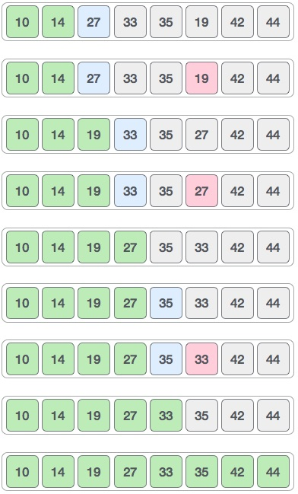
Overview

Slide 7
Algorithm
Step 1 − Set MIN to location 0
Step 2 − Search the minimum element in the list
Step 3 − Swap with value at location MIN
Step 4 − Increment MIN to point to next element
Step 5 − Repeat until list is sorted

Slide 8
Program
#include <stdio.h>
int main()
{
int data[100],i,n,steps,temp;
printf("Enter the number of elements to be sorted: ");
scanf("%d",&n);
for(i=0;i<n;++i)
{
printf("%d. Enter element: ",i+1);
scanf("%d",&data[i]);
}
for(steps=0;steps<n;++steps)
for(i=steps+1;i<n;++i)

Slide 9
Conti..
{
if(data[steps]>data[i])
/* To sort in descending order, change > to <. */
{
temp=data[steps];
data[steps]=data[i];
data[i]=temp;
}
}
printf("In ascending order: ");
for(i=0;i<n;++i)
printf("%d ",data[i]);
return 0;
}

